Slide 1

Quantifying and Evaluating Trust in Automated Systems
Maj Christina Rusnock, PhD (for Jayson Boubin)
Assistant Professor, AFIT

Slide 2
Agenda
Motivation for Trust Measurement
Behavior Measures of Trust
Experiment Environment
Results and Discussion

Slide 3
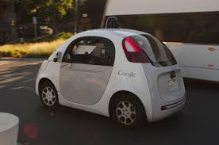
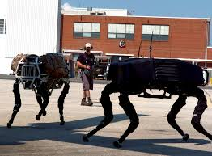
Human-Automation Teams
Increasing prevalence of autonomous systems
Effective teams
  Understand each other’s abilities
  Have open communication
  Have trusting relationship
Trust in automation
  Built over time
  Based on performance consistent
with expectations
  Can be lost
  Can be mis-calibrated
Notes:
As the complexity of automation increases, it becomes more important that the human and automation act as a team.
Humans must trust automation to perform properly, but must also trust themselves to discern incorrect automation actions.
To understand the big picture of “Trust” in automation, we must quantify trust in both ways.

Slide 4
Motivation
DoD Autonomy Task Force and (former) Chief Scientist of the Air Force Mica Endsley:
  Trust in automation is key to user acceptance and adoption of increased levels of autonomy
DoD Autonomy Task Force has requested USecDef AT&L to create developmental and operational test and evaluation techniques that focus explicitly on building trust in autonomous systems
In order to evaluate trust, we need a method of quantifiably measuring trust
Notes:
Under Secretary of Defense for Acquisition, Technology, and Logistics

Slide 5
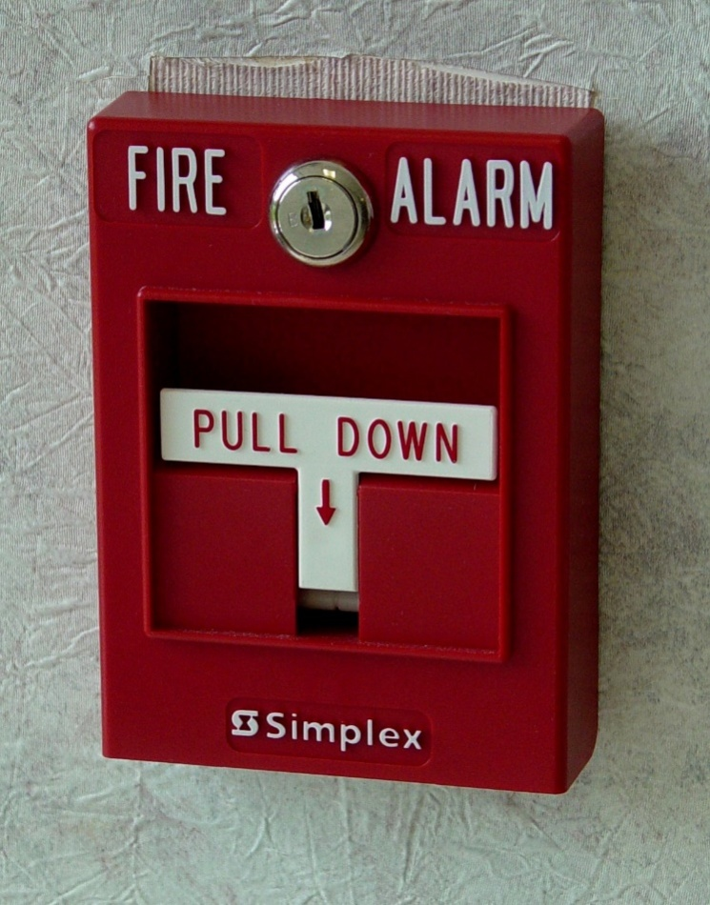
Compliance and Reliance
Automation Alarm literature classifies trust as Compliance and Reliance
  Compliance: operator’s response when an alarm sounds
  Reliance: refers to the operator’s response when the alarm is silent
Pros:
  Measureable from operator’s behavior
  Provides a rate 0-100%
  Have a scale, can make comparisons
Con:
  What if the automation isn’t an alarm?

Slide 6

Quantifying Compliance and Reliance
For non-alarm automation, we can generalize the definitions
Compliance: operator’s acceptance
of automation actions
  Operator behavior
Compliance Rate - % automation actions permitted,
not over-ridden by human
Reliance: operator’s expectation that
automation will take action if required
  Operator behavior
Reliance Rate - % of time automation is allowed to take the first action

Slide 7
Purpose
The purpose of this research is to:
  Extend the definitions of compliance and reliance beyond alarm literature
  Find factors in a system which significantly affect compliance and reliance rates
  Quantify the effects of these factors to create functions which capture compliance and reliance rates

Slide 8
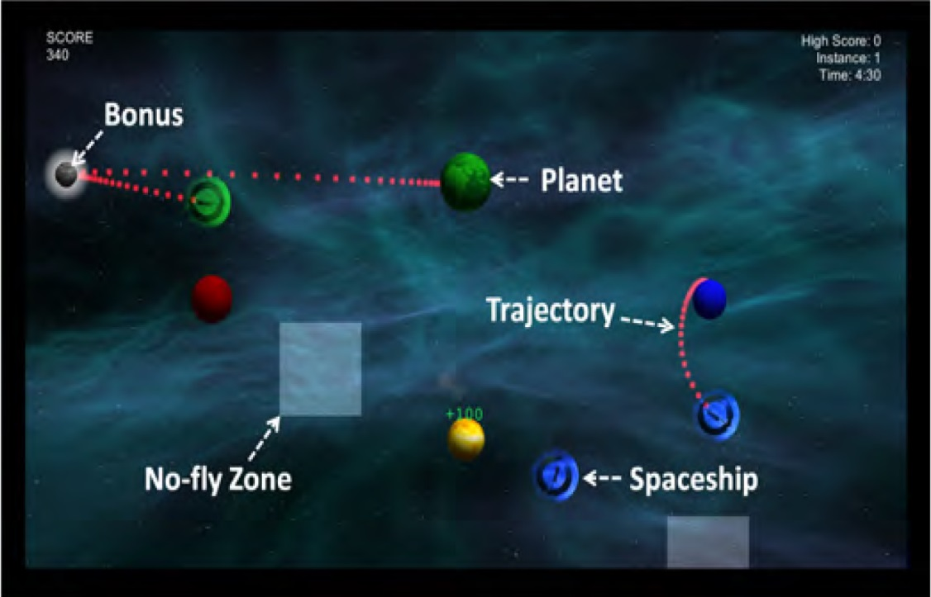
Experimental Environment
Space Navigator:
  Developed at AFIT
  Used to test the effectiveness of Human-Automation Teams
Components:
  Ships
  Planets
  No-fly Zones
  Bonuses

Slide 9
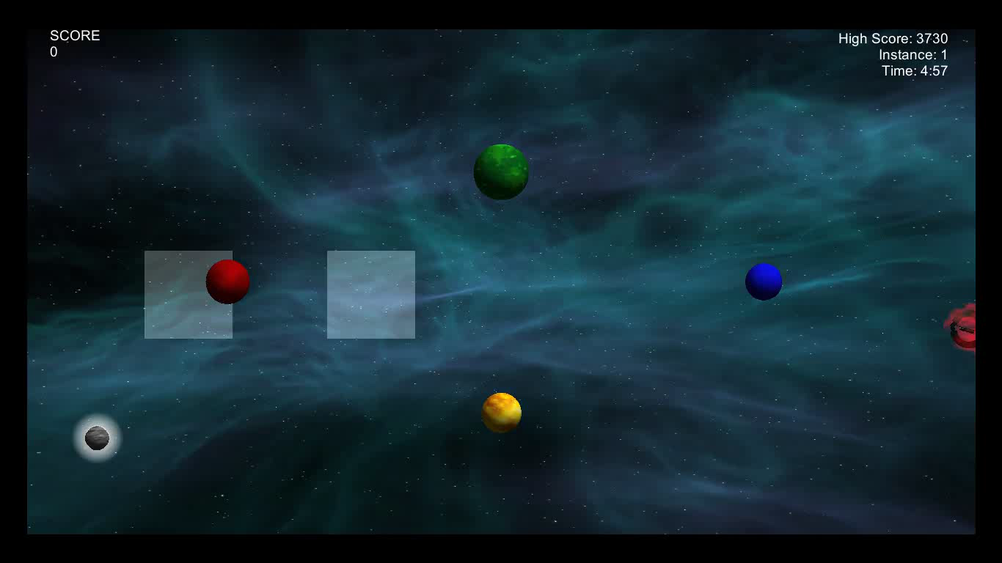
Experimental Environment

Slide 10
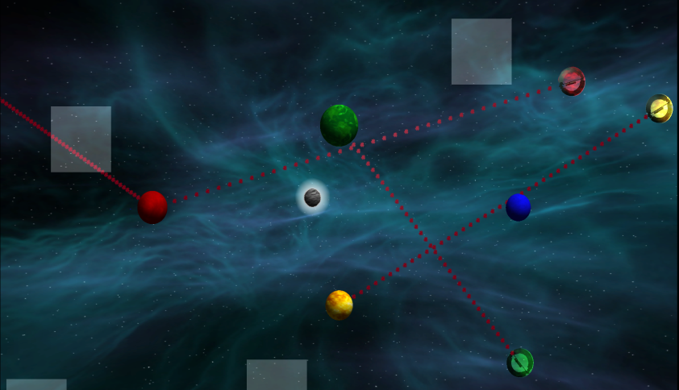

Automation Types
Line Automation
Space Navigator allows automation of ships
Automation Types:
  Similar
  Dissimilar
  Line
Automation only performs route-creation task
  Requires HMT
Similar Automation

Slide 11
IVs and DVs
Independent Variables
  Automation Type
  Task load: # of ships on screen
Dependent Variables
  Compliance: Rate at which operator accepts (does not redraw) routes drawn by the automation
  Reliance: Rate at which operator allows the automation to initially draw ship routes
    Delay 2 sec

Slide 12
Human Data
Data gathered through a HITL experiment
  36 participants (30 males, 6 females)
  Mean age 32.5, st. dev 5.87
Each Played 17 five-minute games
  5 training games – no automation
  12 experimental games
    3 each (no automation, line, similar, dissimilar)
Each automation strategy can be assigned its own compliance and reliance rates

Slide 13

Space Navigator Benefits
Multiple automation types allow for more comprehensive view of trust
Automation types have distinct differences which impact performance
Automation is not a perfect player

Slide 14
Reliance Results:
Automation Type
Reliance rates
  Similar Automation: mean 69.5% sd = 0.162
  Line Automation: mean 66.3% sd = 0.1274
  Dissimilar Automation: mean 59.5% sd = 0.1633
Reliance ANOVA [F(2,105) = 4.045, p = 0.02]
Tukey HSD
  Similar significantly different than dissimilar
  Line automation not significantly different from either similar or dissimilar

Slide 15
Compliance Results:
Automation Type
Reliance rates
  Similar Automation: mean 79.3% sd = 0.1288
  Line Automation: mean 76.3% sd = 0.1027
  Dissimilar Automation: mean 63.8% sd = 0.1622
Compliance ANOVA [F(2,105) = 13.54, p = 5.86E-06 ]
Tukey HSD
  Similar automation significantly different than dissimilar automation
  Line automation significantly different than dissimilar automation, but not similar automation

Slide 16
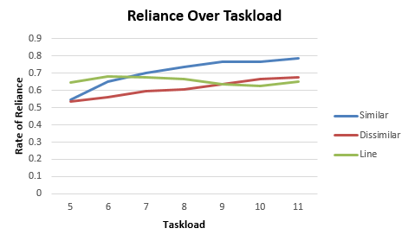
Reliance Results: Taskload
Examined these rates for each discrete level of taskload
  between 5 ships and 11 ships onscreen
Reliance increase with increasing taskload for the Similar and Disimilar automation types
But decreases with increasing taskload for the Line automation

Slide 17
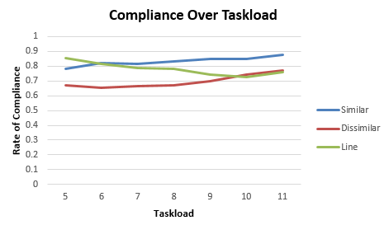
Compliance Results: Taskload
As with Reliance, Complinace rates increase with increasing taskload for the Similar and Disimilar automation types
But decreases with increasing taskload for the Line automation

Slide 18
Data Analysis
Established regression functions to predict reliance and compliance rates based on taskload
Subsequently implemented used for HPM in DES models
Polynomial Regression for Reliance Functions |  |  | Linear Regression for Compliance Functions
Function |  | R² | Function | R²
Similar | R = -0.0072T^{2 + 0.1267T + 0.2354} | 0.9878 | C = -0.0136T + 0.2224 | 0.9027
Dissimilar | R = -0.0029T^{2 + 0.0537T + 0.4045} | 0.9432 | C = -0.0176T + 0.3740 | 0.7808
Line | R = -0.0061T^{2 + 0.0743T + 0.4477} | 0.7619 | C = 0.018T + 0.1464 | 0.7934

Slide 19
Discussion
Compliance/Reliance for Line high at low taskloads
  When few ships are onscreen, straight line performs well
  Strategy over-emphasizes center of screen
Similar and Dissimilar automation avoid the pitfalls of the shortest path strategy
  May make these automation types more enticing as taskload (and the need for automated assistance) increases
Big Picture: trust-based evaluations of autonomous system may be context-sensitive

Slide 20
Conclusion
Extended reliance and compliance beyond alarm literature
Identified automation type and taskload affect compliance and reliance rates
Established functions to predict reliance and compliance rates
The ability to quantify and evaluate trust in automated systems
  Enable system designers to make trust-based trade-offs

Slide 21
Questions?

